Slide 1

Department of Environmental Conservation (DEC) DW Mission
The Drinking Water Program is responsible for requiring public water systems to supply safe drinking water that meets minimum federal health-based standards, established by the Environmental Protection Agency as required by the federal Safe Drinking Water Act.
Public Water Systems
A public water system (PWS) is a system that provides water for human consumption and has at least 15 service connections or regularly serves at least 25 individuals at least 60 days out of the year.
Notes:
The Drinking Water Program is responsible for requiring public water systems to supply safe drinking water for public consumption that meets minimum federal health-based standards, established by the Environmental Protection Agency as required by the federal Safe Drinking Water Act.
Alaska has had primary enforcement responsibility of the Public Water System Supervision program since 1978. (Wyoming and the District of Columbia are not responsible). EPA Region 10 is located in Seattle Washington.

Slide 2
Alaska DEC Drinking Water Program has engineering staff in 4 offices covering approximately 1,400 systems statewide.
Anchorage office has four engineers and one engineering technician and covers the following areas;
  Anchorage Region, Pipeline
  Aleutian Peninsula, Aleutian Chain, Kodiak
  Bristol Bay and YK Delta
446 Total Public Water Systems (PWS) through Anchorage Office
190 of those are PWS off the road system
Notes:
2 arms of DEC drinking water. Compliance and Engineering.

Slide 3
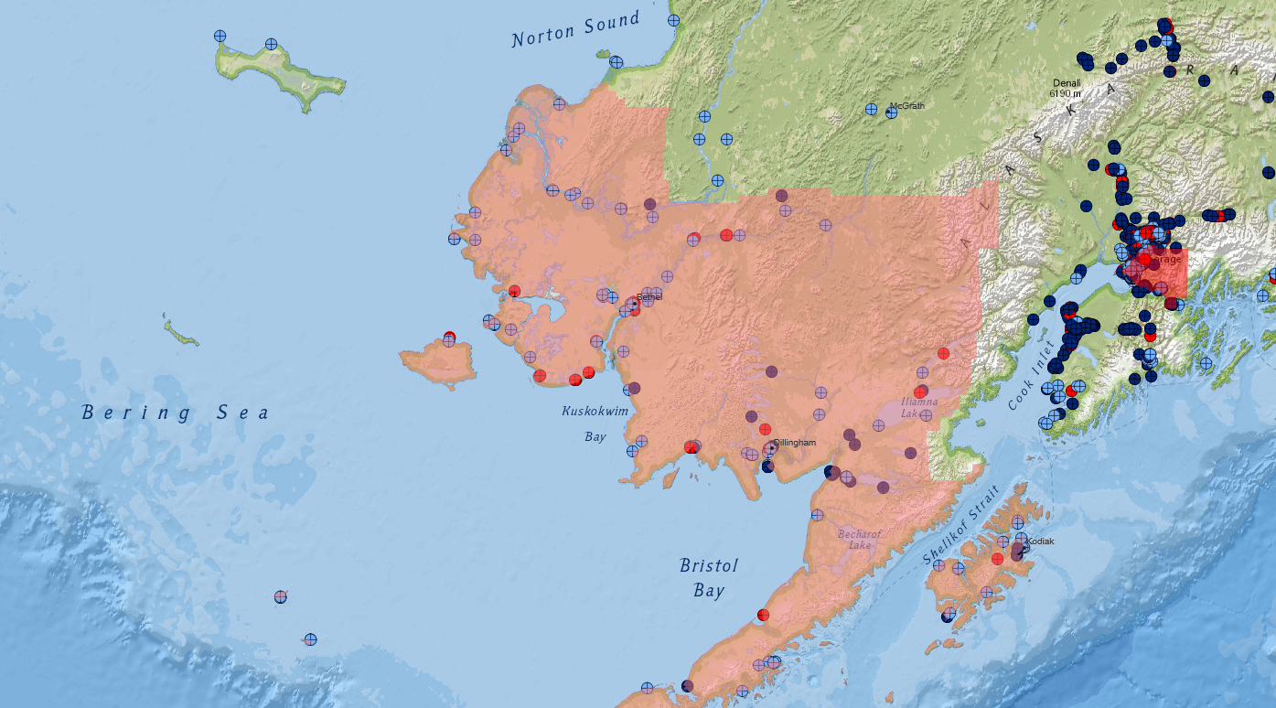
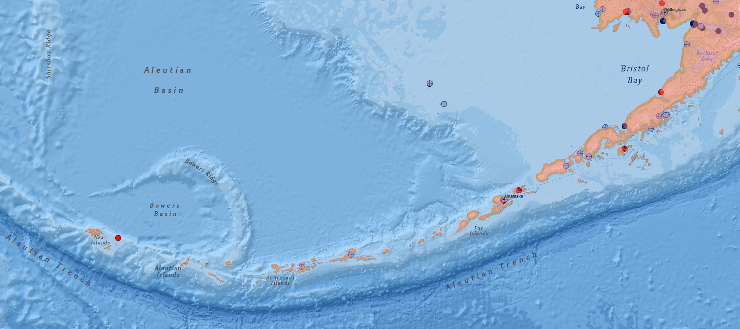
Notes:
2 arms of DEC drinking water. Compliance and Engineering. Roughly 1,400 PWS in Alaska (446 in Anchorage Region), 190 outside of Anchorage (175) and the Pipeline (81).

Slide 4
What does a DEC Drinking Water Engineer Do?
Review and approve engineering design plans for new construction and modifications to public water systems
Verify that proposed changes will not pose a risk of contamination to the drinking water supply
Provide technical assistance to water system owners & operators
Inspect water systems to verify proper operation and maintenance and check for sanitary deficiencies (Sanitary Surveys)
Conduct Status Component Inspections (water treatment plants)
Help water systems optimize their treatment processes to achieve the best possible drinking water quality (Comprehensive Performance Evaluations)
Notes:
Primary Services
Require that public water system owners and operators test drinking water for regulated drinking water contaminants.
Review contaminant monitoring test results from public water suppliers and specify corrective measures where contamination is indicated.
Approve new public water systems and modifications to existing ones.
Regulate minimum health-based standards and procedures for design, construction and operation of Alaska's 1,400 CWS, NTNCWS or TNCWS public drinking water systems.
Implement a statewide drinking water compliance strategy to best assist Alaska water systems in providing cost-effective safe drinking water.
Provide information about contaminant monitoring and sampling procedures to public water system owners and operators, third-party engineering consultants, and stake holders for public water systems.
Respond to complaints of contaminated or damaged public drinking water wells and impacted watersheds.
Maintain a statewide database with monitoring, compliance, and enforcement information on public drinking water systems.
Provide workshops on wellhead protection and source water assessments for communities and public water system owners and operators.
Promote the development and implementation of Drinking Water Protection Plans for communities and public water systems.

Slide 5
Rural and Arctic Construction in Alaska: Lessons Learned and Future Challenges
Permitting Requirements and Procedures for Remote Construction
Permitting Requirements are the same across PWS; 18AAC80 - Drinking Water
Challenges we encounter most often on rural projects;
  Accurate record information is difficult to gather or close the loop on.
  Commissioning and interim requirement(s) expenses are magnified and coordinating can be complicated.
Notes:
Permitting requirements are the same across all PWS.
Record Data – Changes in construction are not always thoroughly documented.

Slide 6
Rural and Arctic Construction in Alaska: Lessons Learned and Future Challenges
Permitting Requirements and Procedures for Remote Construction
Regulatory changes coming up;
  PFAS/PFOA limits are being reviewed (urban environments as opposed to rural challenges).
Changes I would like to see;
  Early project collaboration.
  Participation in regulation changes.

